Slide 1


Institute for Advanced Computing & Software Development (IACSD)
Project Presentation on
SCRAP TRADING SYSTEM
By:
Kazi Aayaj Shabbir (219086)
Shaikh Omair Shaikh Mujahed(219174)
Internal Guide: External Guide:
Shilpa Pawale Kashinath Patil

Slide 2
Contents
Introduction
Scope
Technology
Modules
ER Diagram
Data Flow Diagram
Database Tables
Screenshots of Pages

Slide 3
Introduction
The Scrap Trading System is a platform through which we will connect scrap dealer/merchants with people who are possessing scrap in house and want to sell it at reasonable price.
At this platform we will take description, type, quantity, photos of scrap from seller and put a post on website where other people [buyers/dealer] can explore it and can put bid for it. Then seller will decide who to sell according to various factors like price, pick up time, ease of transport, etc.

Slide 4
Scope
This system allows the Users to easily Buy or Sell the Scrap whenever they need.
With the use of this system, a user can register and then login to the portal and view the scrap posts uploaded by all other users who want to sell their scrap post.
If a user wants to buy the scrap, he can put a bid on it with a suitable amount.
A user can also upload his own scrap post and he can select any bid according to his/her choice.

Slide 5
Technology
We used Java Spring-Boot as backend and React JS as Frontend in our Project.
Spring-Boot :–
The main goal of the Spring Boot framework is to reduce overall development time and increase efficiency. One of the main advantages of Spring Framework is its use of the Dependency Injection pattern. DI makes it much easier to implement the functionality that applications need, and allows to develop loosely coupled, more general classes.
React :–
React allows developers to create large web applications that can change data, without reloading the page. The main purpose of React is to be fast, scalable, and simple.

Slide 6
Modules
Admin
User

Slide 7
USER
1.Seller :
Seller can post about scrap to be sold, with required information. And select the most suitable bid and connect to that bidder.
2.Buyer :
Buyer can see the post of scrap to be sold, bid for desired scrap . If he win the bid then buyer can connect to seller.

Slide 8
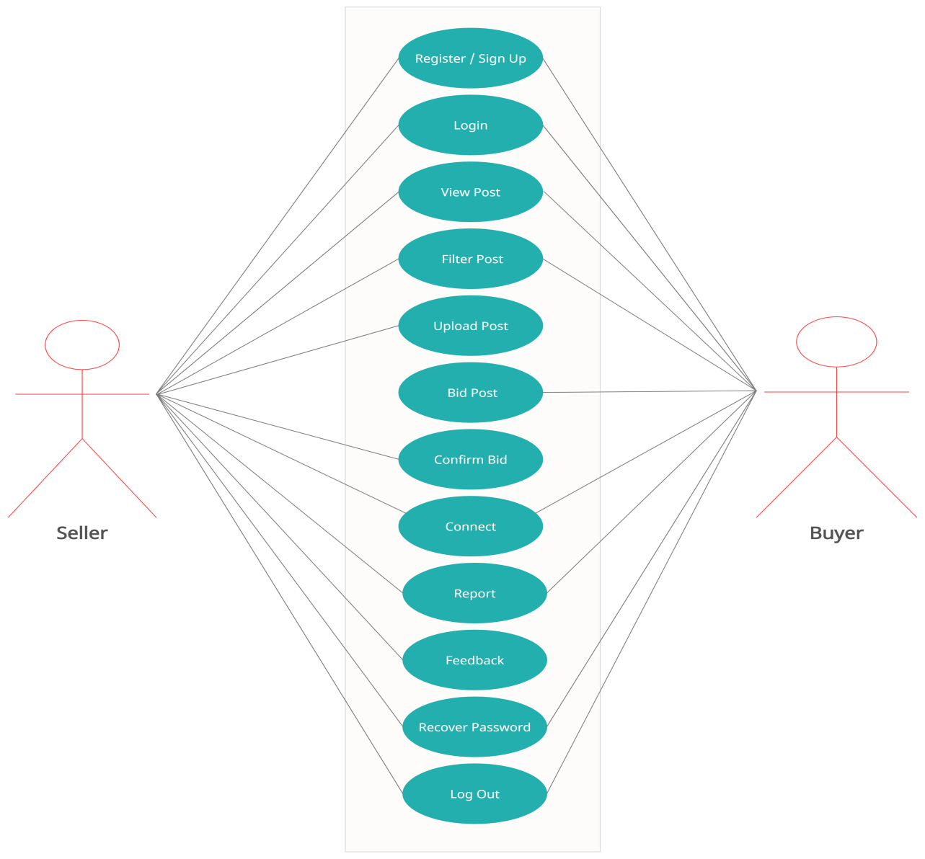
USE CASE DIAGRAM FOR USER

Slide 9
ADMIN
Admin can see uploaded post and user’s information. Also admin can view feedback and reports.
If reports are received about fraud by any particular user about their posts frequently then admin can remove the user.

Slide 10
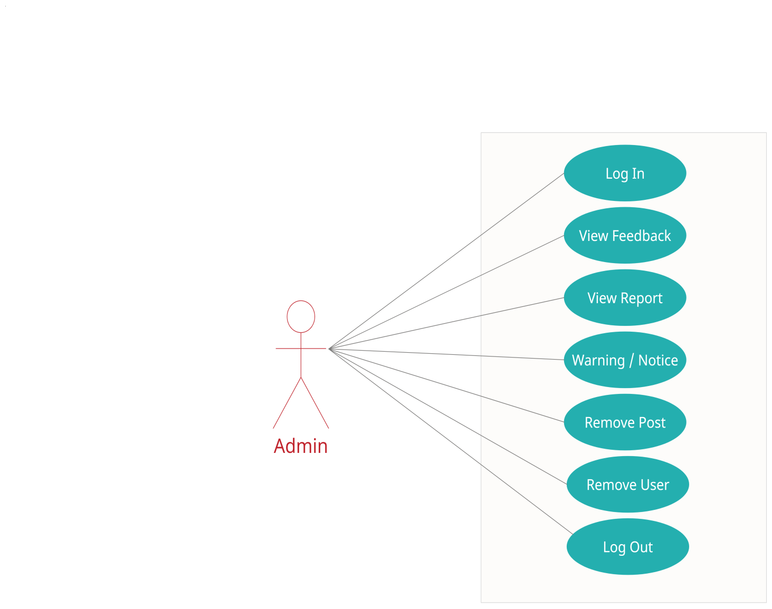
USE CASE DIAGRAM FOR ADMIN

Slide 11
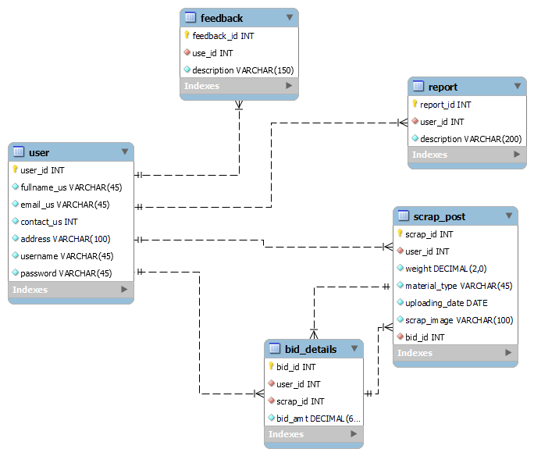
ER-DIAGRAM

Slide 12
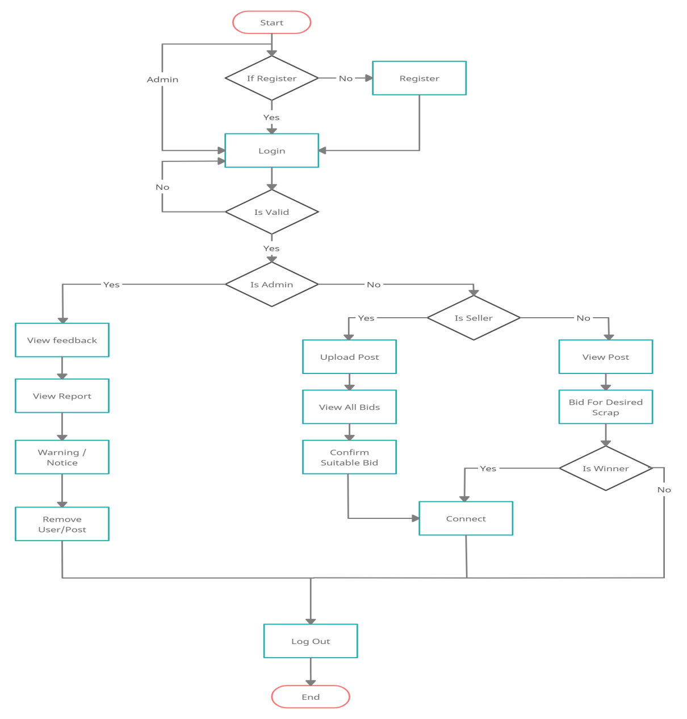
DATA FLOW DIAGRAM

Slide 13
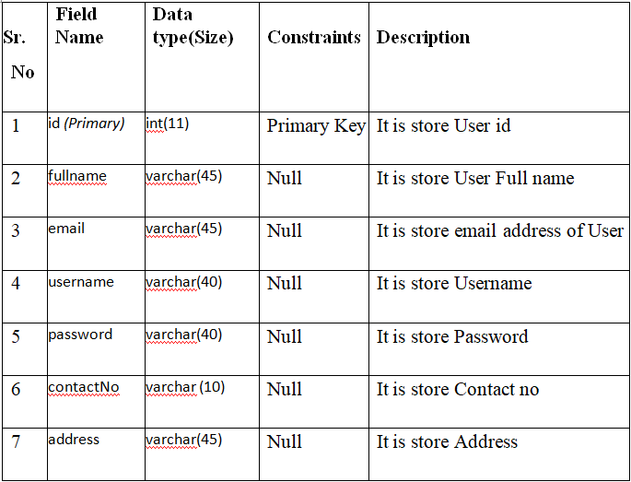
USER TABLE

Slide 14
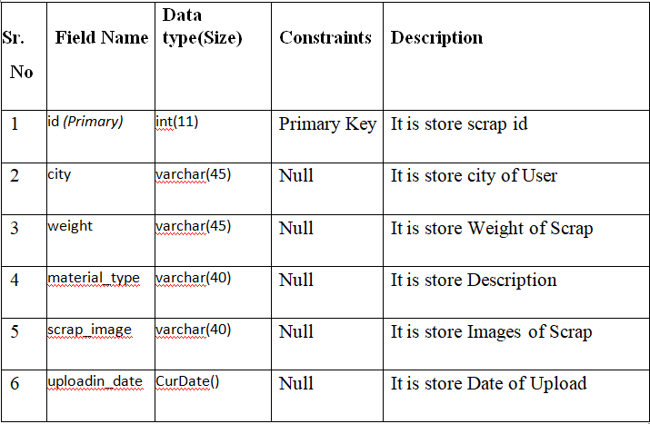
SCRAP POST TABLE

Slide 15
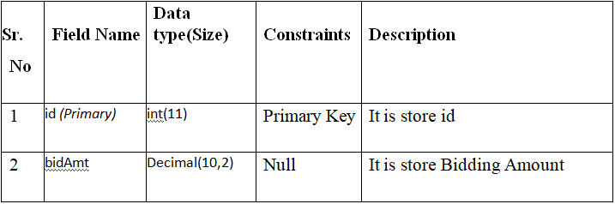
BID DETAILS

Slide 16
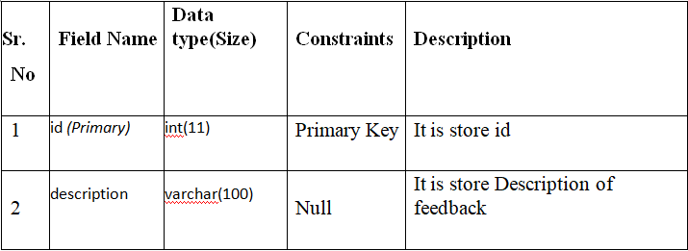
FEEDBACK TABLE

Slide 17
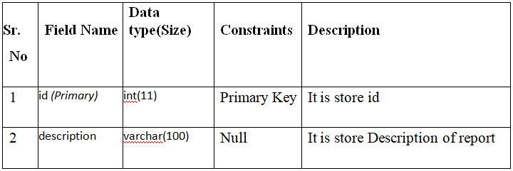
REPORT TABLE

Slide 18
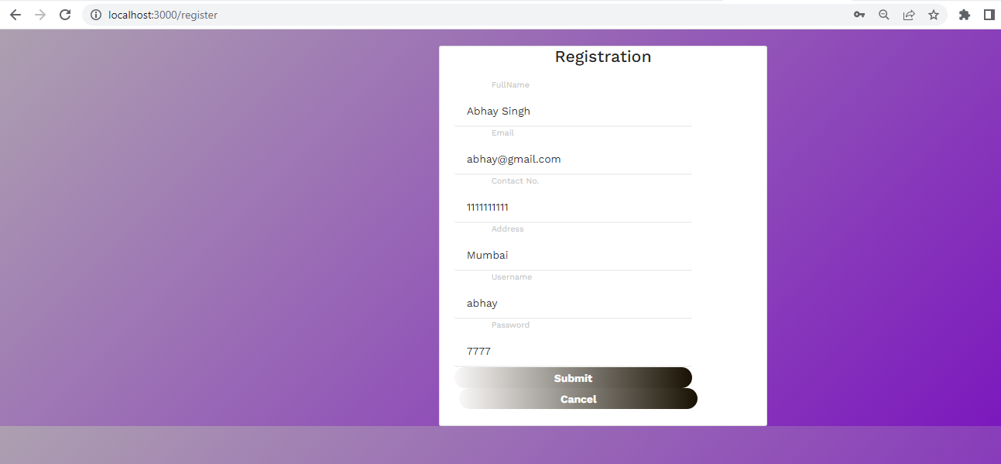
User Registration

Slide 19
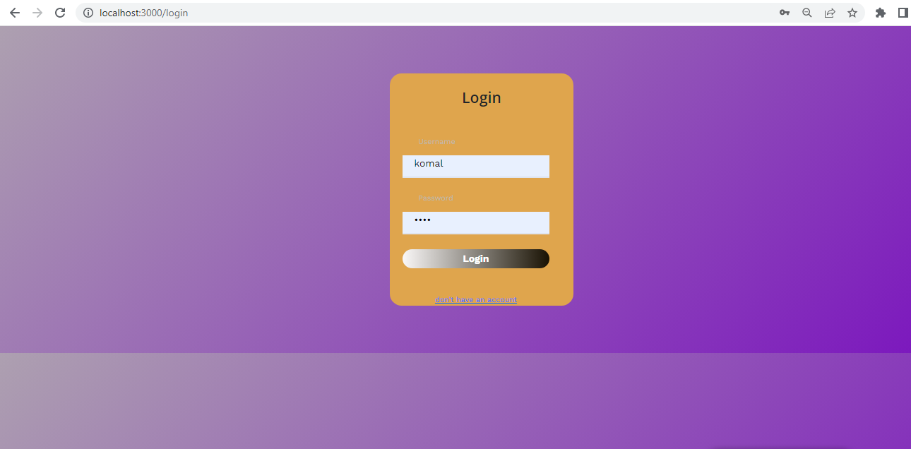
Login Page

Slide 20
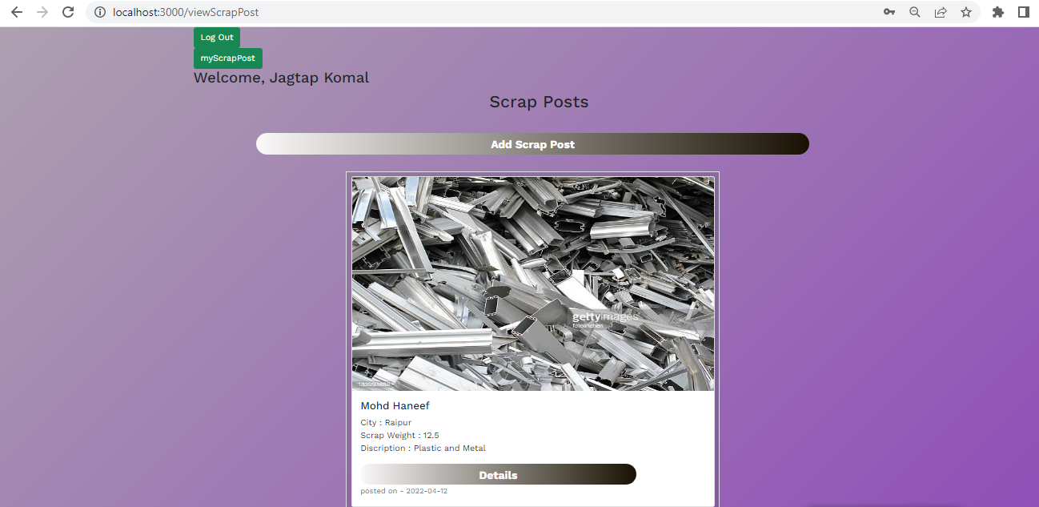
Scrap Posts Page

Slide 21
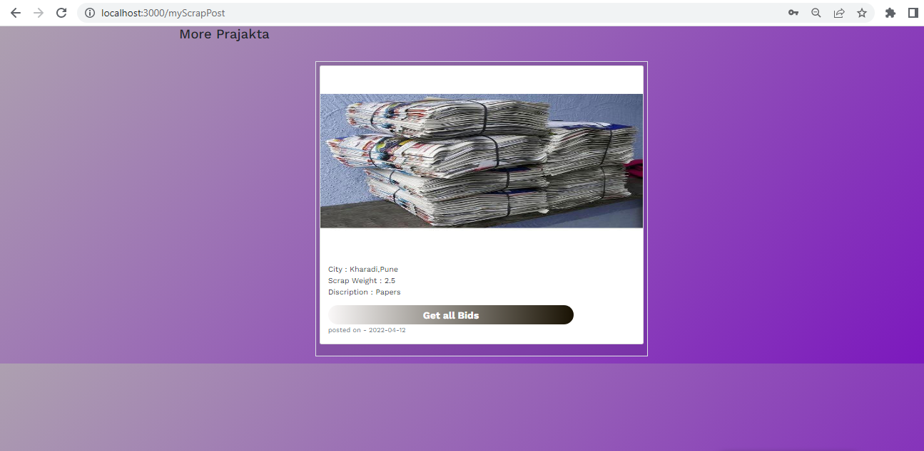
View Uploaded Scrap Posts

Slide 22
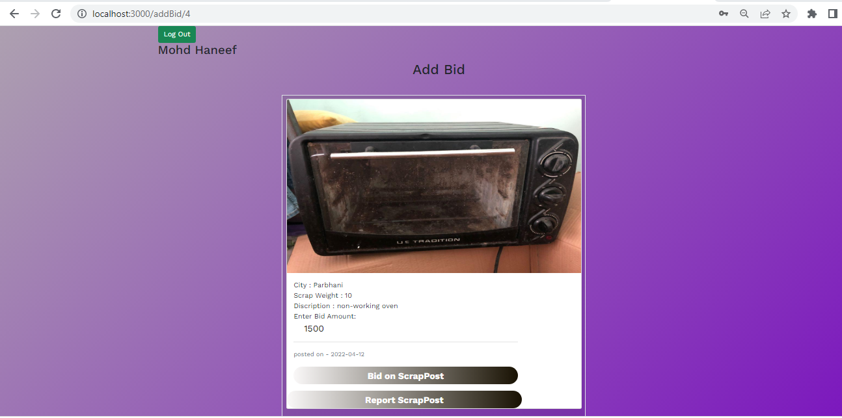
View Individual Scrap Post and Bid

Slide 23
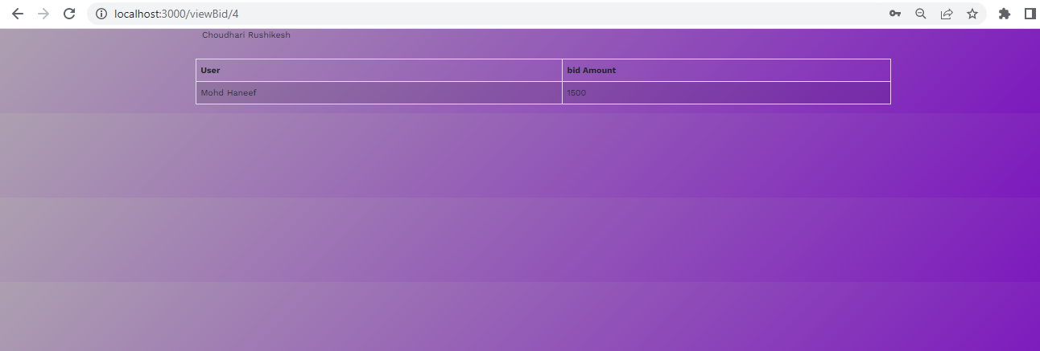
View Bids on your Scrap Post

Slide 24
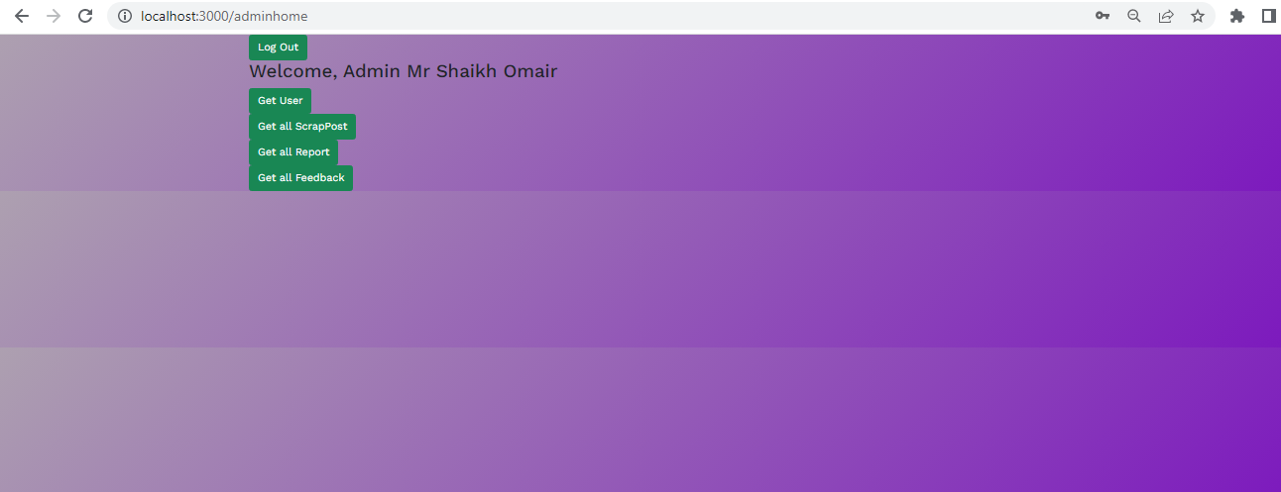
Admin Home Page

Slide 25
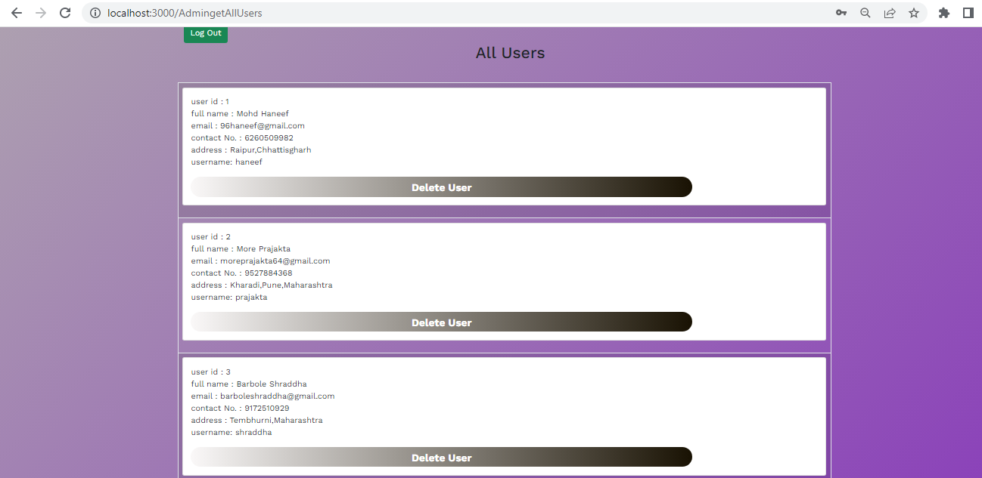
View Users Page of Admin Side

Slide 26
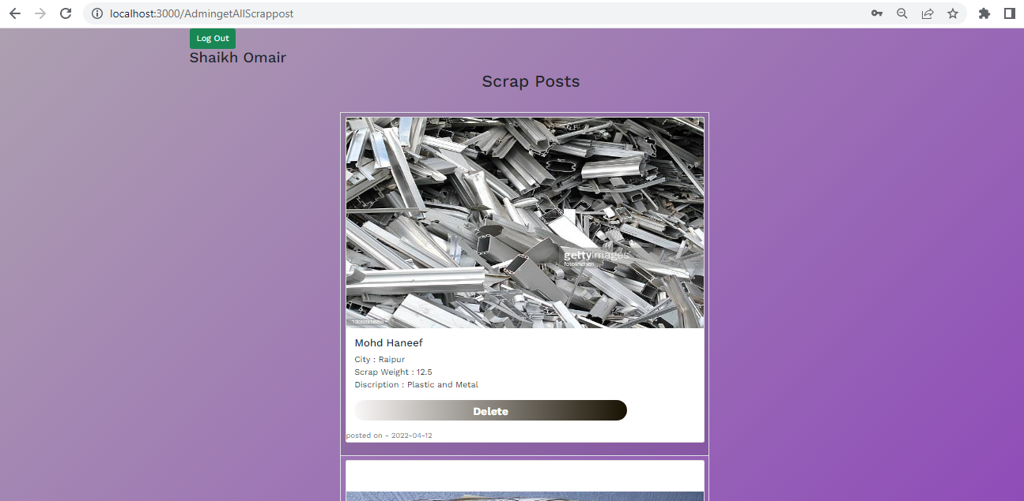
View Scrap Posts Page of Admin Side

Slide 27
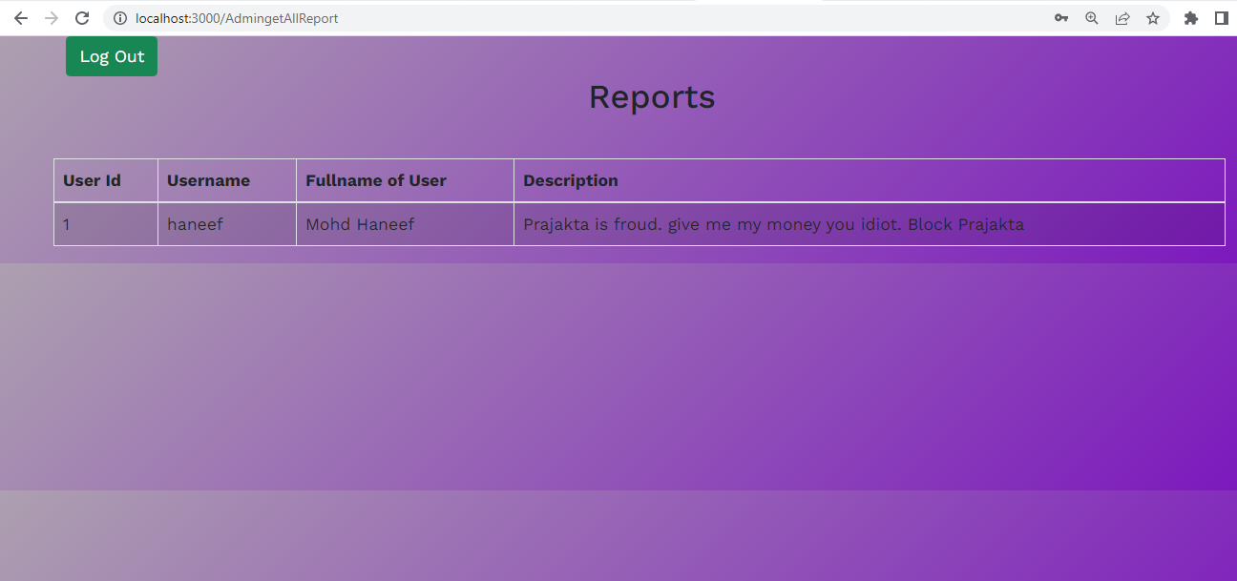
View Reports Page

Slide 28
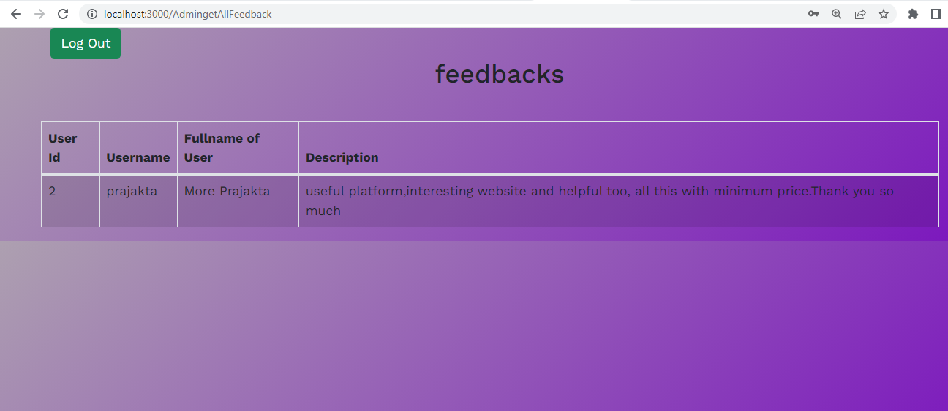
View Feedbacks

Slide 29
THANK YOU

